Slide 1
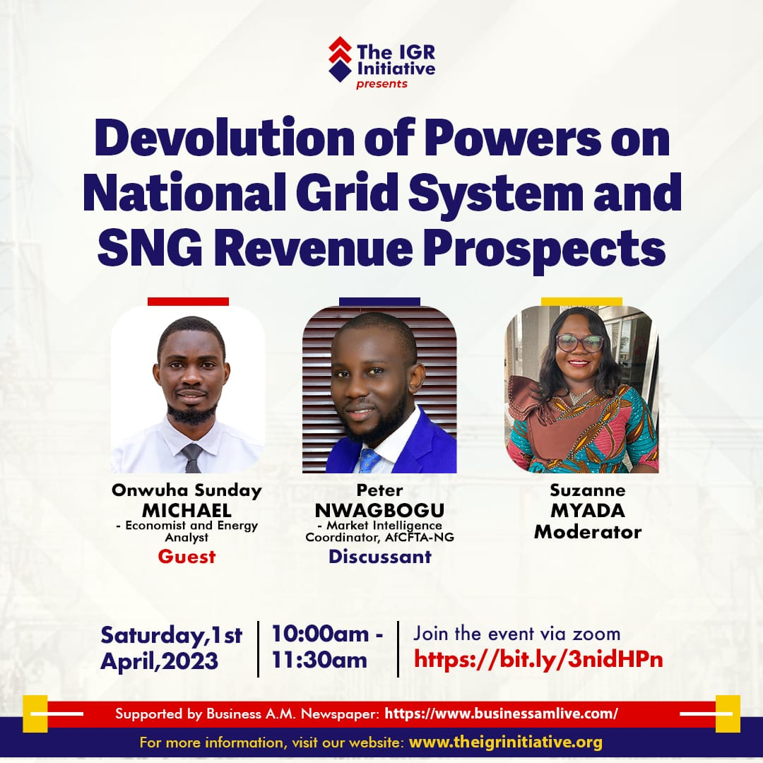

Slide 2
OUTLINE
Nigeria Grid System: Facts and Features.
The Amended Law: Key Take-aways.
Nigeria Electricity Market.
Proposed State Participation Model.
Revenue Growth Pathways.
Recommendations.

Slide 3
Nigeria Grid System: Facts and Features.
Features
facts
Vertically Integrated/Unbundled.
Unidirectional system.
11 Distribution companies, 6 Generation companies and a Transmission company.
Constant collapse( 7 in 2022, partial and total)
Often described as obsolete.
13GW installed capacity(30GW by 2030)
80% gas fired.
4GW – 5GW transmission capacity.
23 power generating plants nationwide.

Slide 4
The Amended Law: Key Take-aways.
States can License, Generate, Transmit and Distribute. Electricity within the state only.
State Assemblies can make laws on electricity.
Development of Integrated Electricity Policy and Strategic Implementation Plan.
Gave legal backing to Renewable Energy development.
Prohibition of funds receipt by distribution companies from electricity consumers to purchase electricity transformers.
Gender mainstreaming in the design and implementation of electricity projects and programmes.
Prison term and fines for electricity theft.

Slide 5
Nigeria Electricity Market.
Governance Structure/Players
Market Analysis
Federal Ministry of Power.
Nigerian Electricity Regulatory Commission.
Electricity Generation Companies (GenCos)
Transmission Company of Nigeria (TCN)
Electricity Distribution Companies(DisCos)
Nigerian Bulk Electricity Trading Plc.
8.35GW(2018) Peak demand(15GW by 2025)
Residential sector consumes 60% of generated electricity.
Lowest tariff in the region.
Projected thermal power domination till 2030.

Slide 6
Proposed State Participation Model.
Vertical Integration Model-State Ownership.
Deregulation Model( PPP).

Slide 7
Revenue Growth Pathways.
Primary Sources:
Secondary Sources:
License charges.
Taxes.
Wheeling charges.
Sale of electricity.
Fines and penalties.
Job creation.
Increased investment.

Slide 8
Recommendations.
Establishment of state electricity board.
Promulgation of state electricity laws.
Ensuring transparency and accountability in the sector.

Slide 9
THANK YOU!

