Slide 1
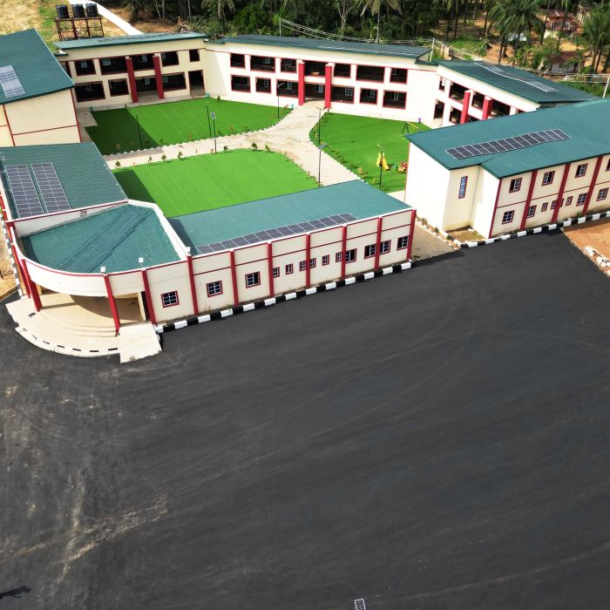
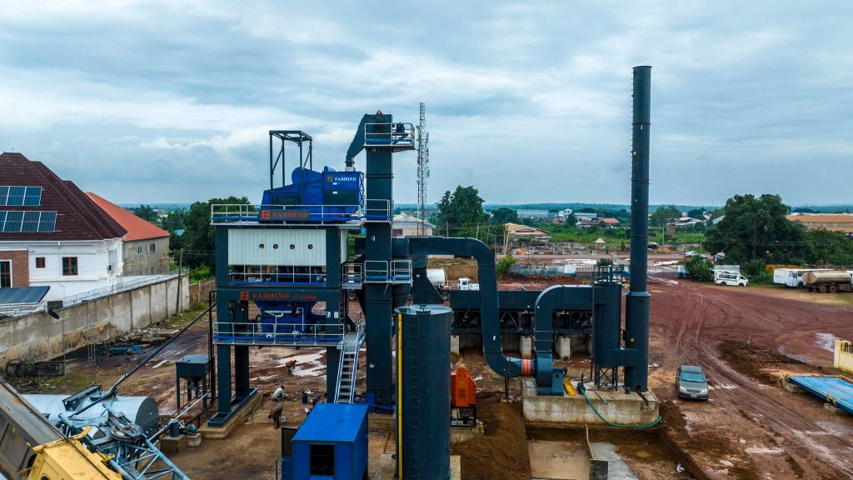
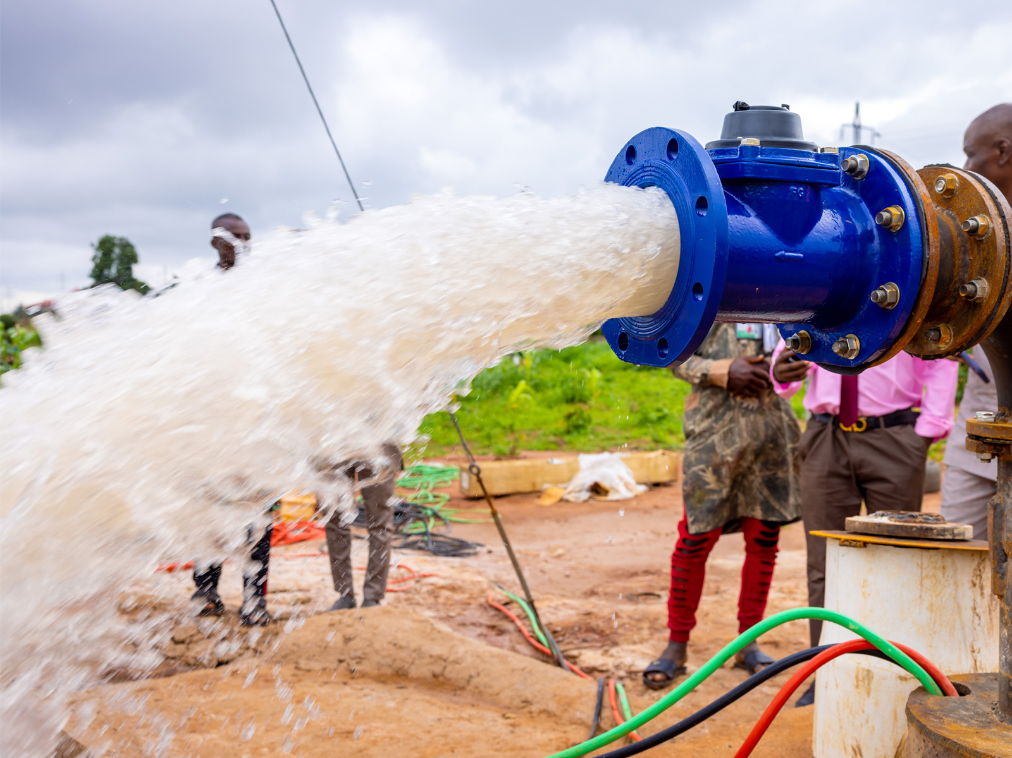
All Eyes on Enugu State: Lessons from Innovative IGR Reforms, Successes & Challenges

Slide 2
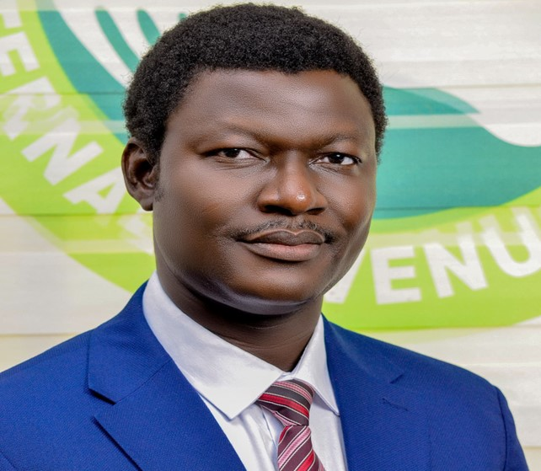
All Eyes on Enugu State: Lessons from Innovative IGR Reforms, Successes & Challenges
Emmanuel Ekene Nnamani, FCTI, FCA
The Executive Chairman of the Enugu State Internal Revenue Service (ESIRS)

Slide 3
What we have done
Expand payment Gateways
Stopped Cash Collection/Revenue Contracting
Unlocked our assets for revenue
Onboard all MDAs into the CMS
Built Central Management System
Autonomy of Service
Eticket collection (Informal Sector)
Trained and motivated Staff
Property Taxes

Slide 4
Successes Achieved
Revenue Jumped up
Staff Motivated
Technology
Basic Infrastructure boomed
Residents Accepted our taxes
Processes became simplified

Slide 5
Challenges
MDAs alignment
Some Official still instating in Direct transfers
Technology drags
Social media attacked on us
People issues

Slide 6
Thank You

